Slide 1

Database:
Blood Donation System

Slide 2

Introduction
The database designed aims to store, manage and retrieve the data of blood donation campaigns, donors, hospitals and blood banks in an effective way.
A major real-time benefit of this database could be hassle free access to information about available blood group in any blood bank.

Slide 3
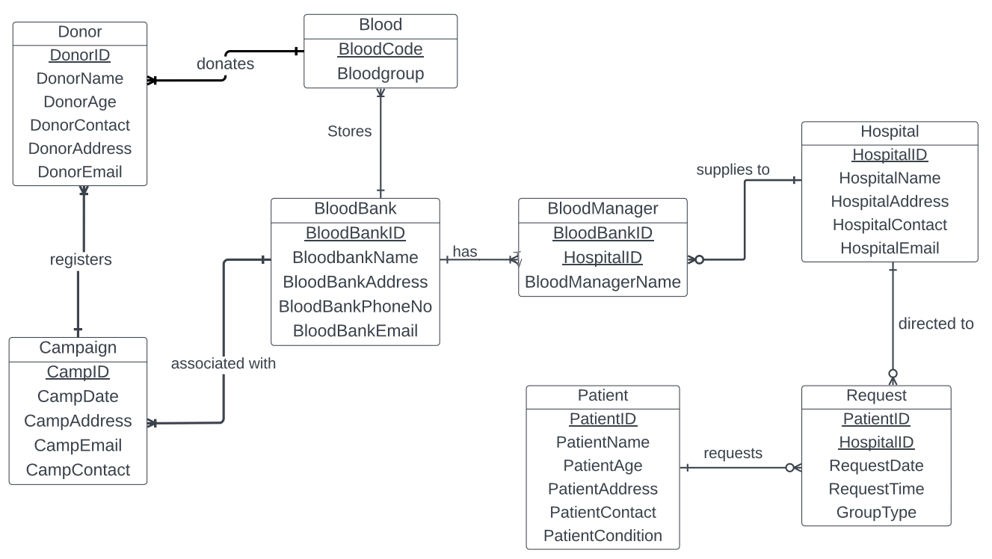
ER Diagram

Slide 4
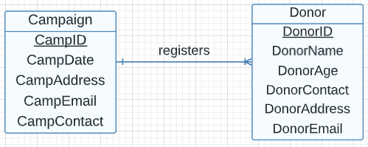
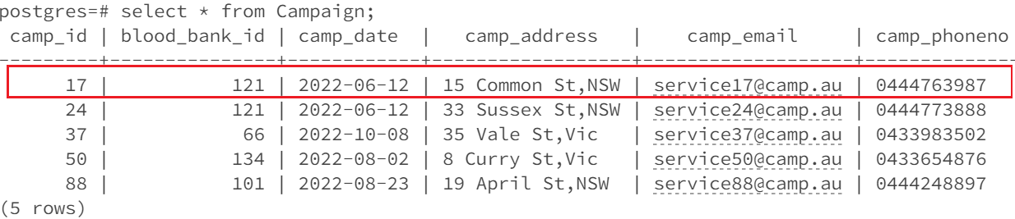
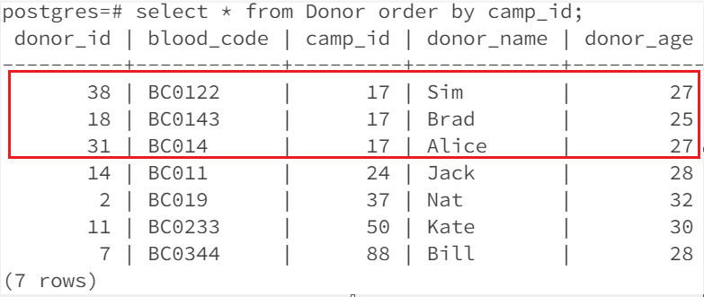
One – Many Relationship
As seen above, ‘Campaign’ and ‘Donor’ has One-Many relationship.
The Campaign_ID 17 has multiple donors registered and every camp has at least one donor entry.
Every donor hence should be associated with one campaign.

Slide 5
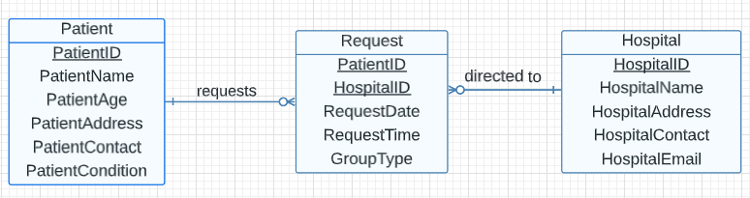
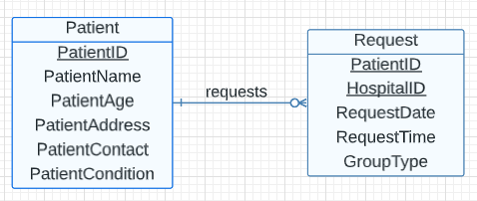
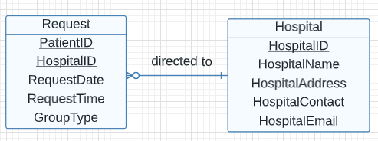
Many – Many Relationship
As seen above, ‘Patient’ and ‘Hospital’ has Many-Many relationship.
Hence, the linking table ‘Request’ splits them into single one- many and
many – one relation.

Slide 6
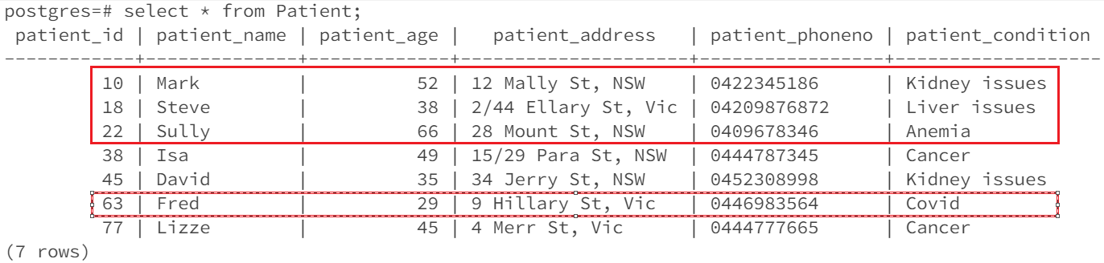
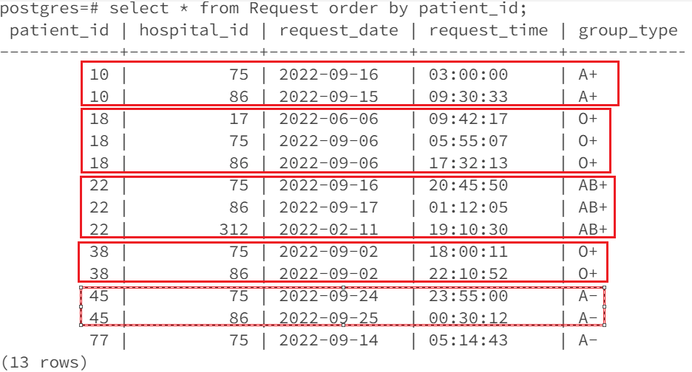
Single One – Many
As seen, one Patient can make multiple requests to many hospitals .
It is also possible that the patient may not raise a request for blood at all.
For instance, Patient_ID 63 has
not raised any request.

Slide 7
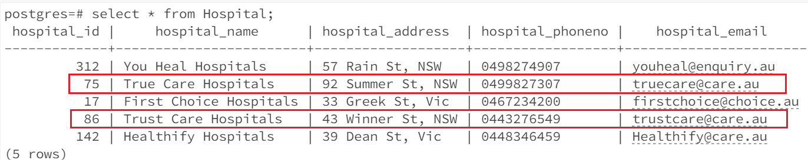
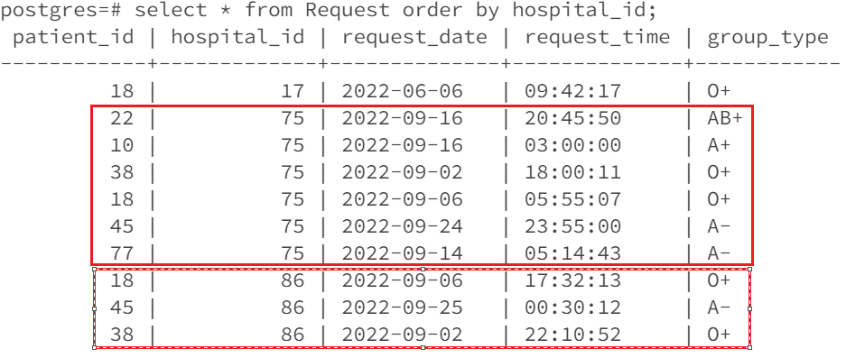
Single Many – One
As seen, one Hospital can receive many requests.
Every request thus should be directed to at least one hospital

Slide 8
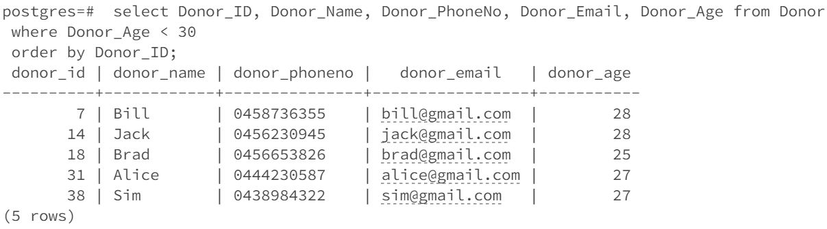
Query 1: A simple query of a single table
SELECT Donor_ID, Donor_Name, Donor_PhoneNo, Donor_Email, Donor_Age
FROM Donor
WHERE Donor_Age < 30
ORDER BY Donor_ID;
Question : List the ID, name, age and contact information of all donors whose age is less than 30 years.

Slide 9
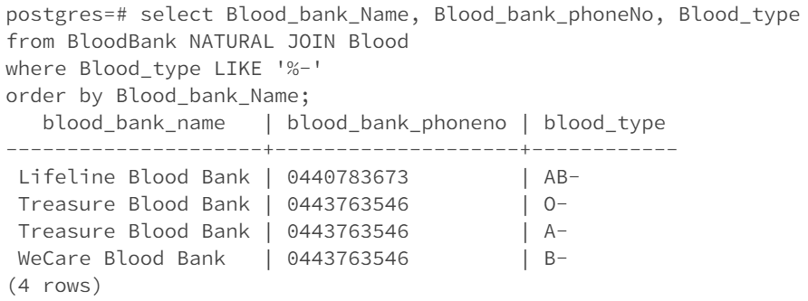
Query 2: A query which uses the words "natural join"
SELECT Blood_bank_Name, Blood_bank_phoneNo, Blood_type
FROM BloodBank NATURAL JOIN Blood
WHERE Blood_type LIKE '%-’
ORDER BY Blood_bank_Name;
Question : List Blood banks(Blood bank name, Contact number) and bloodtype of all blood banks where negative blood type is available.

Slide 10
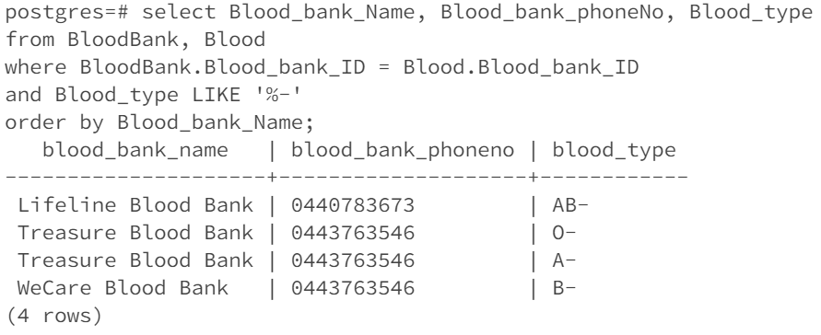
Query 3: The cross-product equivalent to the "natural join" query in the previous slide
SELECT Blood_bank_Name, Blood_bank_phoneNo, Blood_type
FROM BloodBank, Blood
WHERE BloodBank.Blood_bank_ID = Blood.Blood_bank_ID
and Blood_type LIKE '%-’
ORDER BY Blood_bank_Name;

Slide 11
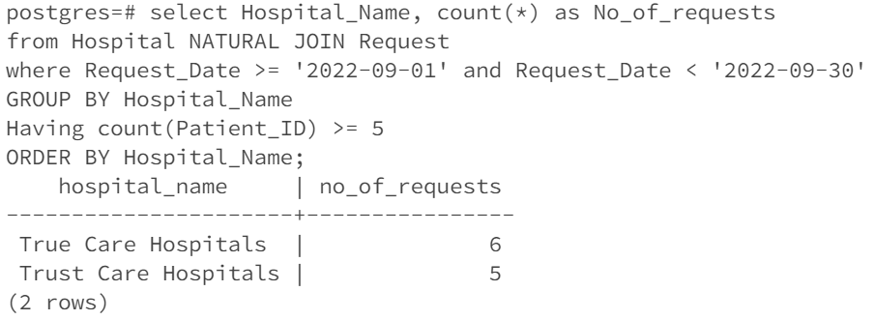
Query 4: A query involving a “Group by”, perhaps also with a “HAVING”
SELECT Hospital_Name, count(*) as No_of_requests
FROM Hospital NATURAL JOIN Request
WHERE Request_Date >= '2022-09-01' and Request_Date < '2022-09-30'
GROUP BY Hospital_Name
HAVING count(Patient_ID) >= 5
ORDER BY Hospital_Name;
Question : List the names of the hospitals with atleast 5 requests in the last month.

Slide 12
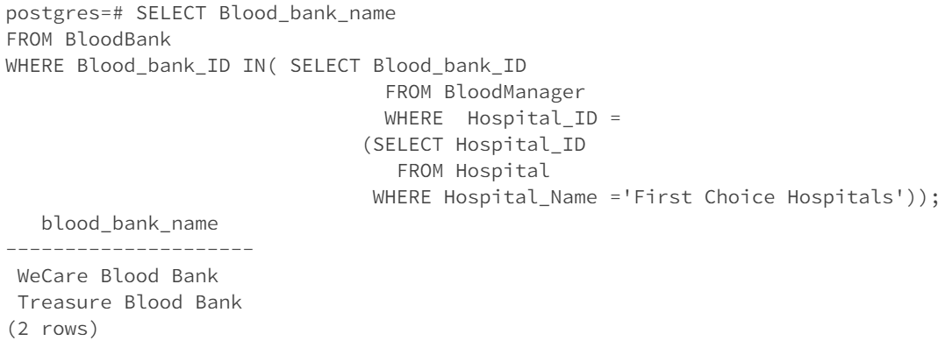
Query 5: A query which uses a sub query.
SELECT Blood_bank_name
FROM BloodBank
WHERE Blood_bank_ID
IN(SELECT Blood_bank_ID FROM BloodManager
WHERE Hospital_ID =
(SELECT Hospital_ID FROM Hospital
WHERE Hospital_Name ='First Choice Hospitals'));
Question : Select the name of the blood banks who are associated with 'First Choice Hospitals'

Slide 13
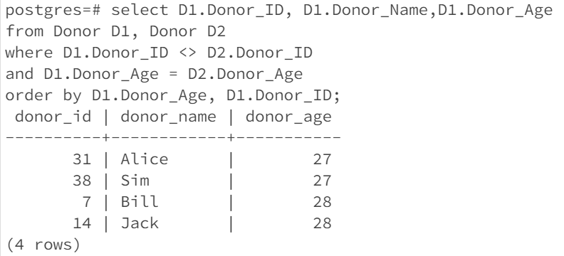
Query 6: A cross product which cannot be implemented using the words “natural join”
SELECT D1.Donor_ID, D1.Donor_Name,D1.Donor_Age
FROM Donor D1, Donor D2
WHERE D1.Donor_ID <> D2.Donor_ID
AND D1.Donor_Age = D2.Donor_Age
ORDER BY D1.Donor_Age, D1.Donor_ID;
Question : List the Donors who are from the same age group

Slide 14
Check Statements
The different CHECK statements used in the SQL are below:
To ensure valid Blood_type is stored in the database
CONSTRAINT check_Blood_type CHECK
(Blood_type in ('A+','A-','AB+','AB-','B+','B-','O+','O-’))
2. To ensure only 10-digit phone number is entered starting with zero
CONSTRAINT check_Donor_PhoneNo CHECK (Donor_PhoneNo ~ '^0\d{9}’)
3. To ensure correct format of Email ID is stored in the database
CONSTRAINT check_Donor_Email CHECK (Donor_Email LIKE '%_@__%.__%')

Slide 15
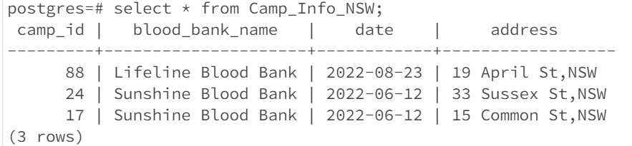
Views
Below SQL creates a view that displays the details of blood camps organised in New South Wales.
CREATE VIEW Camp_Info_NSW AS
SELECT Camp_ID, Blood_bank_name, Camp_date as Date, Camp_Address as Address
FROM Campaign NATURAL JOIN BloodBank
where Camp_Address LIKE '%NSW’;

